Slide 1






Progress Meeting PM9
Galileo Information Centre for Mexico, Central America and the Caribbean
07/09/2023

Slide 2
Welcome
Progress review at M9
Project way forward – next steps
Review of actions and risks
AoB
Closure

Slide 3
Welcome

Slide 4
Progress Meeting 9
ID | Milestone | Date | ID | Meeting | Location | Status
KOM | Kick-off-meeting | 21/01/2021 | KOM | Kick Off Meeting | Online | Held
M1 | Planning phase - Project Review #1 | 26/04/2021 | PM1 | Progress meeting #1 | Online | Held
M2 | Project Review #2 | 17/09/2021 | PM2 | Progress meeting #2 | Online | Held
M3 | Project Review #3 | 20/12/2021 | PM3 | Progress meeting #3 | Online | Held
M4 | Project Review #4 | 20/04/2022 | PM4 | Progress meeting #4 | Online | Held
M5 | Project Review #5 | 01/06/2022 | PM5 | Progress meeting #5 | Online | Held
MTR | Mid-term review | 06/09/2022 | MTR | Midterm review | Online | Held
M6 | Project Review #6 | 08/11/2022 | PM6 | Progress meeting #6 | Online | Held
M7 | Project Review #7 | 24/01/2023 | PM7 | Progress meeting #7 | Online | Held
M8 | Project Review #8 | 04/05/2023 | PM8 | Progress meeting #8 | Online | Held
M9 | Project Review #9 | 07/09/2023 | PM9 | Progress meeting #9 | Online | Today
M10 | Project Review #10 | Month 33 | PM10 | Progress meeting #10 | Online | Planned
FPR | Final Project Review | Month 36 | FM | Final meeting | Online | Planned

Slide 5
Progress review at M9

Slide 6
Status of the Project consortium
AEM contribution
Welcome Agencia Espacial Mexicana (AEM) as a subcontractor.
Task |  | Leader | Contributor
WP1000 Identification of relevant markets and stakeholders |  | TPZ IB
T1100 | Monitoring the GNSS market and local GNSS initiatives | TPZ IB
T1200 | Mapping the key GNSS players/stakeholders from Mexico and the region | Everis
T1300 | Elaboration of a contact database to feed the centres’ activities. | Everis
WP2000 Promotion and awareness raising of European GNSS programmes |  | TPZ IB
T2100 | Elaboration and deployment of a communication strategy | TPZ IB
T2200 | Elaboration and dissemination of a set of documents on European Union GNSS programmes | TPZ IB
T2300 | Set-up and maintenance of a website | TPZ IB
T2400 | Organisation of information sessions on the Horizon Europe Research and Innovation | TPZ IB
T2500 | Participation in GNSS conferences and trade exhibitions | TPZ IB | AEM
T2600 | Support to the integration of Galileo in the region’s plans for GNSS | TPZ IB | AEM
WP3000 Facilitate the development of GNSS-related applications |  | TPZ
T3100 | Provision of ideas for new GNSS applications and services to industrial partners | TPZ SPA
T3200 | Support the development of new GNSS applications | TPZ SPA
T3300 | Support the deployment of new GNSS applications based on Galileo | TPZ IB
WP4000 Education and training on GNSS-related issues |  | UPM
T4100 | Cooperation between Universities from Mexico to provide high-level education including PhD | UPM
T4200 | Provision of courses and organisation of training seminars in the field of GNSS technology and applications | UPM
T4300 | Promotion and demonstration activities related to training | UPM
WP5000 Facilitation of joint industrial collaborations between Latin American and European partners |  | TPZ IB
T5100 | Organisation of matchmaking events for industry representatives | TPZ IB | AEM
T5200 | Fostering closer contacts between entities involved in GNSS | TPZ IB | AEM
T5300 | Facilitation of several high-level meetings and EC/GSA outreach | TPZ IB | AEM
T5400 | Interface with the European External Action Service (EEAS) | TPZ IB | AEM
T5500 | Interface with the chambers of commerce | TPZ IB | AEM
WP6000 MANAGEMENT |  | TPZ IB
T6100 | Contractual management | TPZ IB | AEM
T6200 | Management of the Centre’s own documents. | TPZ IB
T6300 | Management of interfaces with other GICs. | TPZ IB

Slide 7
Project organisation
WP 6000
MANAGEMENT
[TPZ IB]
WP1000
Markets and stakeholders in Mexico and the region
[TPZ IB]
WP2000
Promotion of European GNSS programmes
[TPZ IB]
WP5000
Industrial collaborations between Latin American and European partners
[TPZ IB]
WP3000
Facilitate the development of GNSS-related applications
[TPZ SpA]
WP4000
Education and training on GNSS-related issues
[UPM]
Interface with GICs & GSC
[TPZ IB]

Slide 8
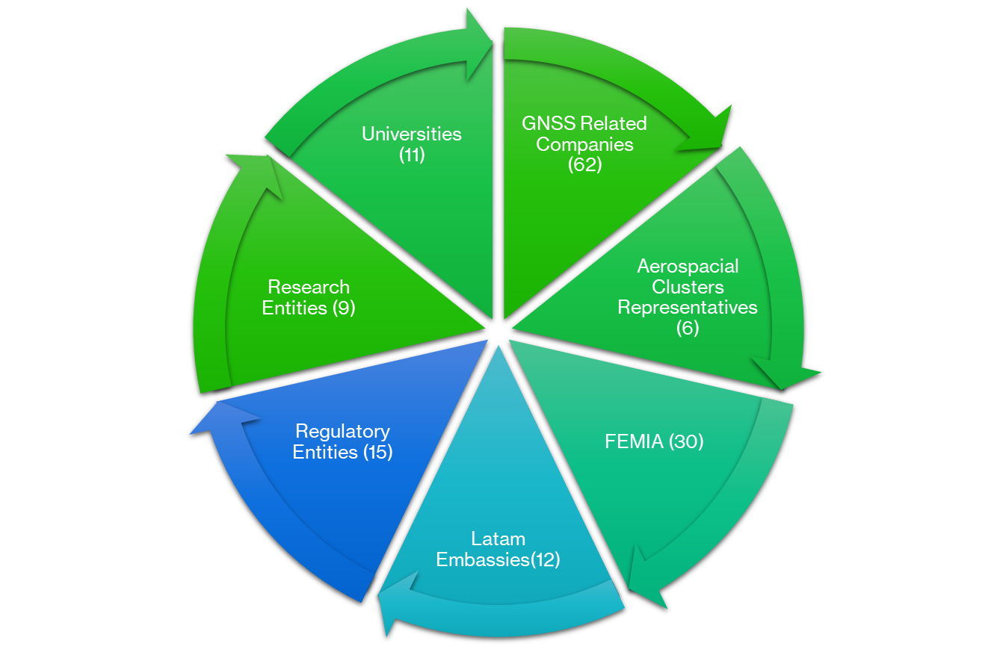





WP1000 - Markets and stakeholders in Mexico and the region (TPZ IB)
T1300: Elaboration of a contact database to feed the centres’ activities
  Database in Excel format updated with new contacts this reporting period:
    Contacts made at FAMEX2023 (22)
    Contacts provided by EEAS-Tegucigalpa as a result of the GNSS course online posted on the GIC website (33)
Attendees to Industry Day at FAMEX 2023
m1 | m2 | m3 | m4 | m5 | m6 | m7 | m8 | m9 | m10 | m11 | m12 | m13 | m14 | m15 | m16 | m17 | m18 | m19 | m20 | m21 | m22 | m23 | m24 | m25 | m26 | m27 | m28 | m29 | m30 | m31 | m32 | m33 | m34 | m35 | m36
T1100
T1100
T1100
T1200
T1200
T1200
T1300
T1300
T1300
T1300
D1.1. GNSS downstream market in Mexico and in the region.
D1.2 GNSS stakeholders in Mexico and in the region.
D1.3 Contacts dataset
D1.1. Update
D1.2 Update
D1.3 Update
D1.1. Update
D1.1. Update
D1.2 Update
D1.3 Update
D1.3. Update
D1.3. Update
D1.3 Update
D1.3 Update

Slide 9
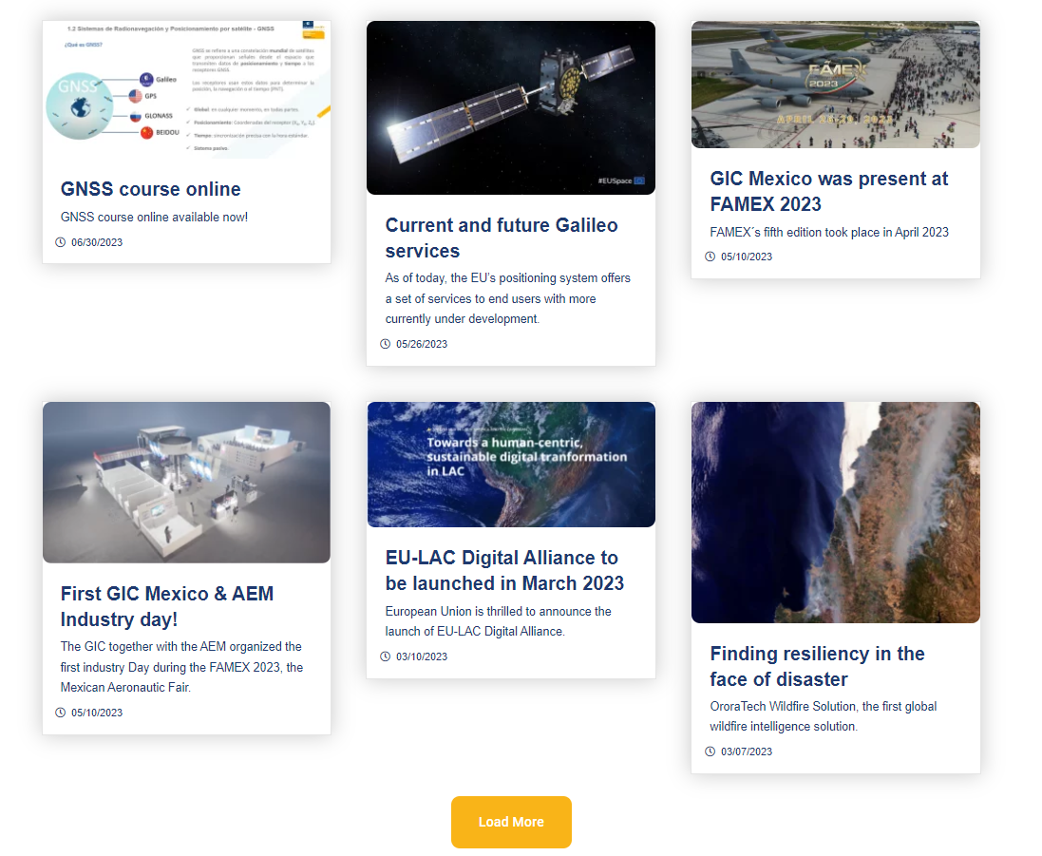

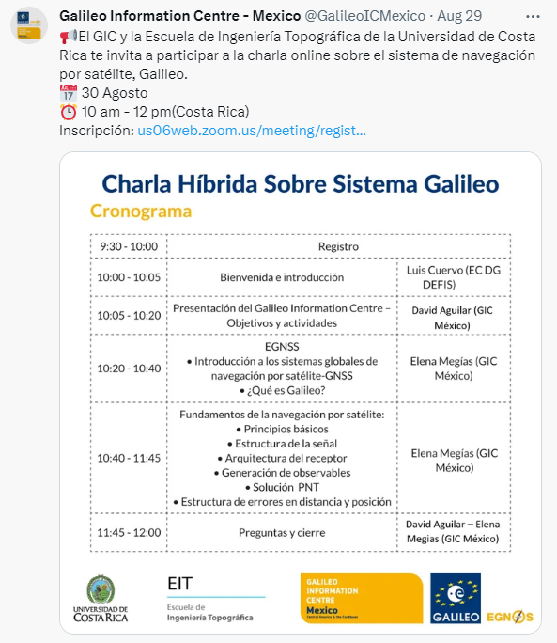

WP2000 - Promotion of European GNSS programmes (TPZ IB)
T2100: Elaboration and deployment of a communication strategy (TPZ IB)
  Continuous communication continued through social networks and the web page (in line with the Communication strategy)
    4 GNSS related and GIC relevant news published in the GIC web page (https://galileoic-mexico.com/news/)
    3 post on social networks (https://twitter.com/GalileoICMexico/ https://www.linkedin.com/company/galileo-information-centre-mexico/)
T2100

Slide 10
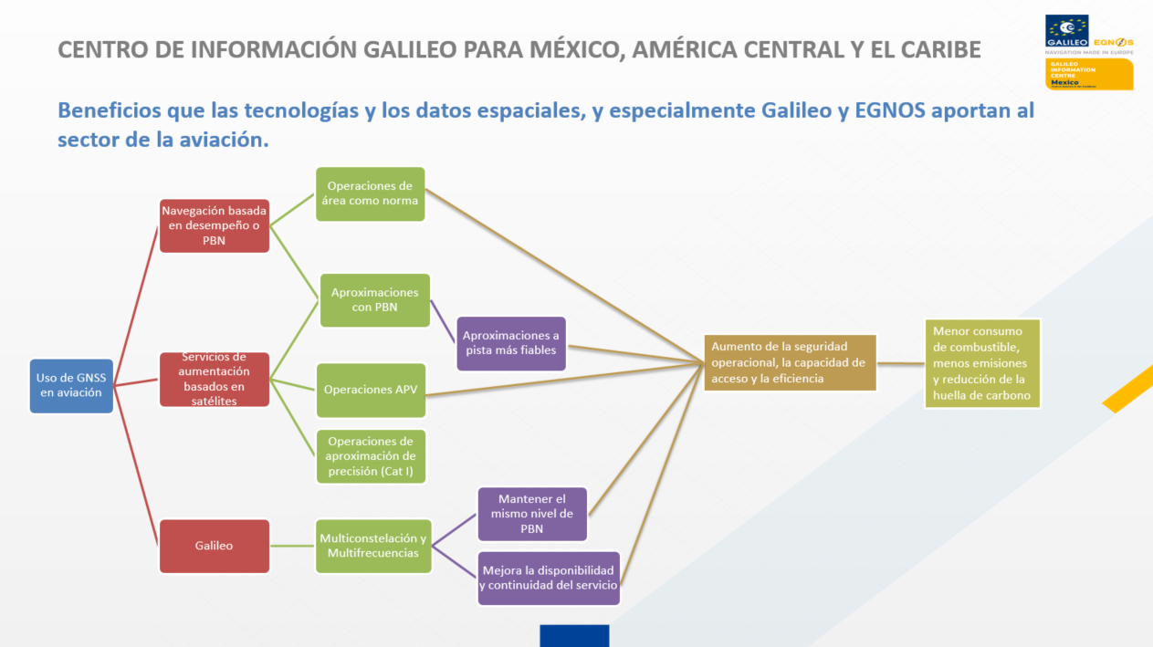
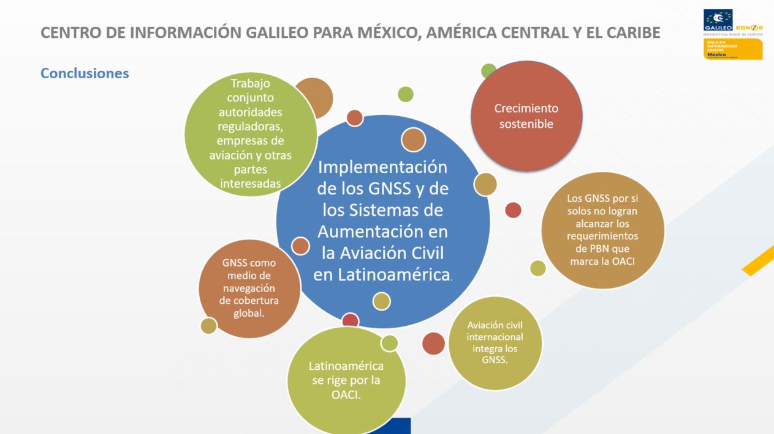

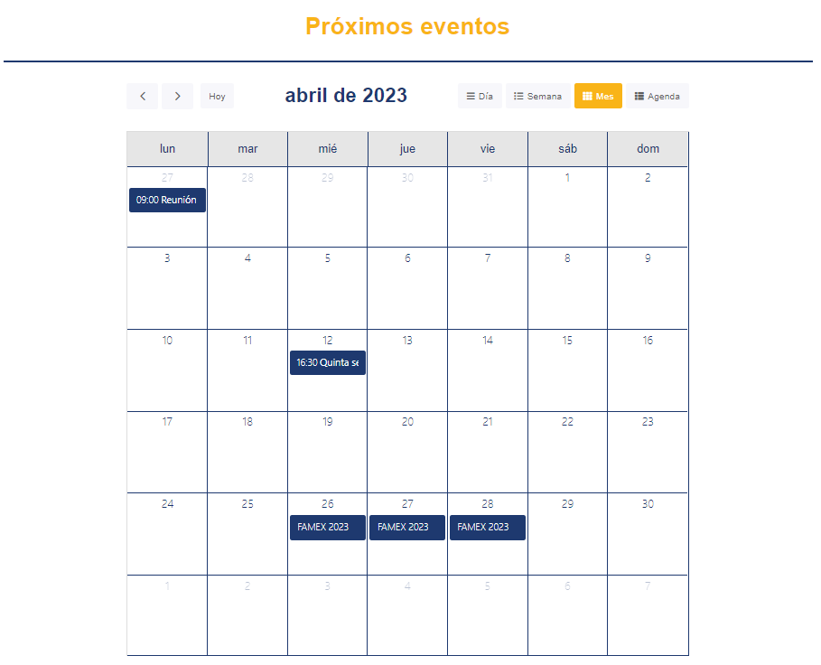

WP2000 - Promotion of European GNSS programmes (TPZ IB)
T2200: Elaboration and dissemination of a set of documents on European Union GNSS programmes (TPZ IB)
  New communication material has been developed:
  Presentations used in events:
    Industry Day (FAMEX23)
    Sessions for the winners of the #GICKathon2022
T2300: Set-up and maintenance of a website (TPZ IB)
Update of the website with new company news to keep visitors coming back to the site.
Planned events have been added to the “Agenda” section of the GIC website
A new “GNSS course online” sub-section under Webinars section has been created on the GIC website.

Slide 11
WP2000 - Promotion of European GNSS programmes (TPZ IB)
T2500: Participation in GNSS conferences and trade exhibitions (TPZ IB)
  FAMEX 2023 (26-29 April 2023) in Mexico:
    GIC corner at the UNAM stand
    Participation in the Industry Day together with the AEM on April 27 with
      Conference on the GIC and European Space Programmes
      Round table on GNSS applied to aviation and drones in Latin America
      Industrial workshop on geolocation and satellite navigation systems
  Hybrid webinar on the Galileo System at the School of Topographic Engineering of the University of Costa Rica (30/08/2023)
    Participation T2600: Support to the integration of Galileo in the region’s plans for GNSS (TPZ IB)
  First Meeting held between ALCE, AEM and GIC Telespazio Iberica will develop this activity, with the local support of the AEM.
T2500
m1 | m2 | m3 | m4 | m5 | m6 | m7 | m8 | m9 | m10 | m11 | m12 | m13 | m14 | m15 | m16 | m17 | m18 | m19 | m20 | m21 | m22 | m23 | m24 | m25 | m26 | m27 | m28 | m29 | m30 | m31 | m32 | m33 | m34 | m35 | m36
T2100
T2200
T2300
T2400
T2500
D2.1. Update
D2.2 Update
D2.5 Update
T2600
D2.1. Update
D2.2 Update
D2.5 Update
D2.6 Roadmap for Galileo in the region’s plans for GNSS
D2.2 D2.4
D2.3 D2.5
D2.5 Update
D2.6 Update
D2.5 Update
D2.2 Update
D2.5 Update

Slide 12
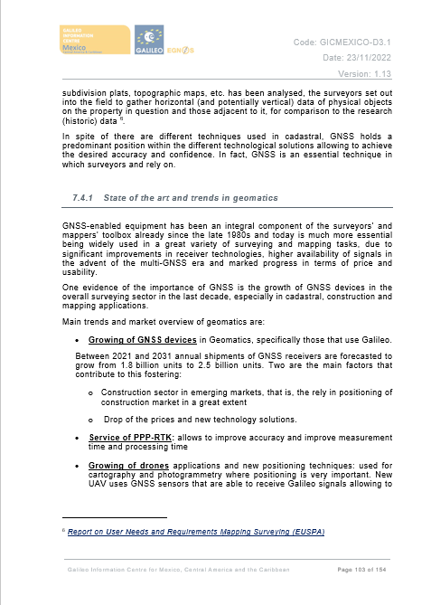
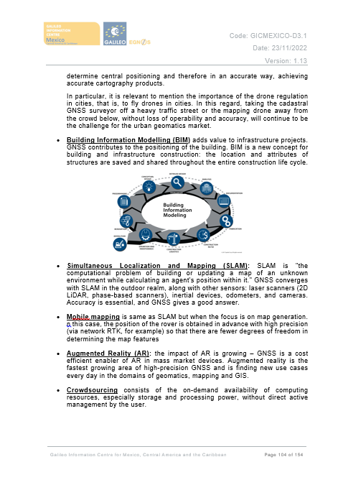
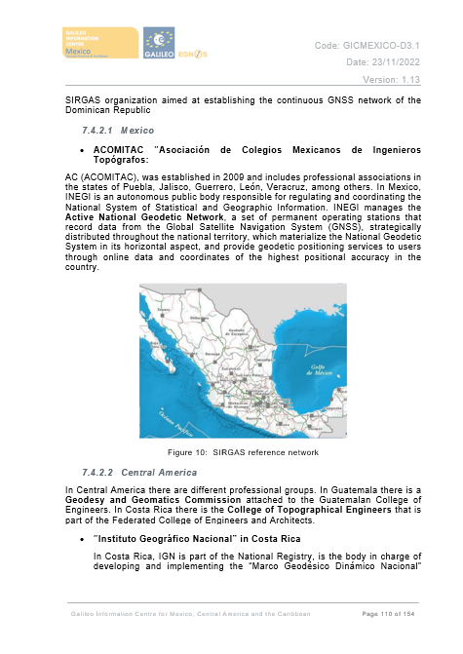
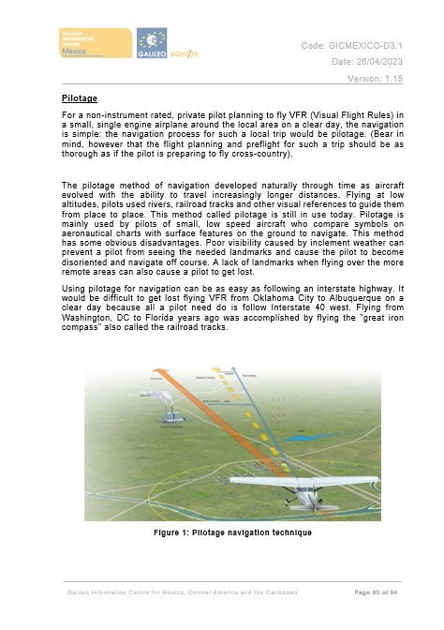
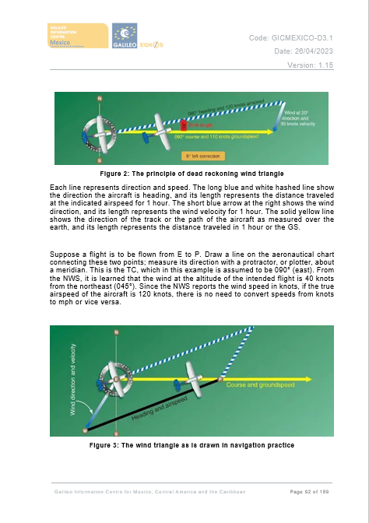
WP3000 - Facilitate the development of GNSS-related applications (TPZ IT)
T3200: Support New EGNSS Applications development (TPZ SpA)
  The GIC has been working on the technical notes:
    Six technical notes, Drones, Agriculture, Road, Geomatics, Aviation and emergencies, are completed.
    These technical notes are currently under review by the EC.
    When approved by the EC, they will be available on the GIC website.
    An updated of D3.1-Plan for development of GNSS related applications has been delivered to the EC on 21st July 2023.
T310
T3100
T3200
T3300
T3300

Slide 13
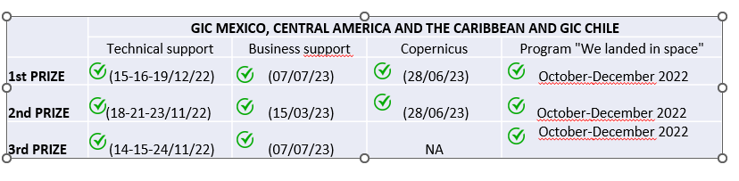
WP3000 - Facilitate the development of GNSS-related applications (TPZ IT)
T3300: Support Deployment of new GNSS applications (TPZ IB)
  In this period the focus has been on providing support sessions to the three winners of the GalileoGICkathon 2022.
T310
m1 | m2 | m3 | m4 | m5 | m6 | m7 | m8 | m9 | m10 | m11 | m12 | m13 | m14 | m15 | m16 | m17 | m18 | m19 | m20 | m21 | m22 | m23 | m24 | m25 | m26 | m27 | m28 | m29 | m30 | m31 | m32 | m33 | m34 | m35 | m36
T3200
T3100
T3300
T3200
T3300
Table of Contents
D3.1 Plan for development of GNSS-related application and services in Mexico and in the region
D3.1 First version
D3.1 Update
D3.1 Update
D3.1 Update
D3.1 Update
D3.1 First version

Slide 14
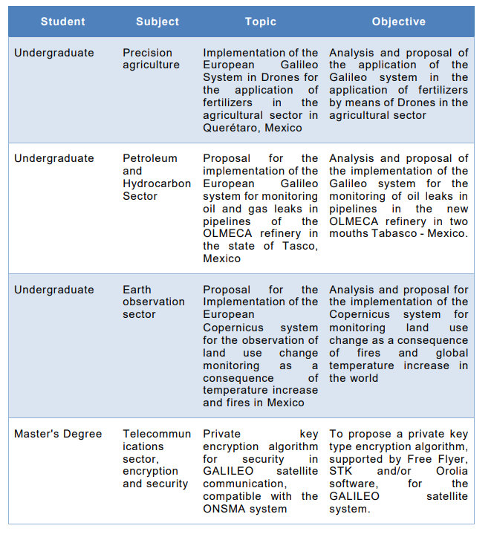
WP4000 - Education and training on GNSS-related issues (UPM)
T4100: Cooperation between Universities from Mexico to provide high-level education including PhD
  Thanks to the promotion and awareness raising of the European satellite system Galileo among the students of the UNAM due to the delivery of the GNSS course, 4 students that were searching for a thesis topic have decided to work on GNSS technology and applications related topics. Three of them are undergraduates and one is a Master’s student.

Slide 15
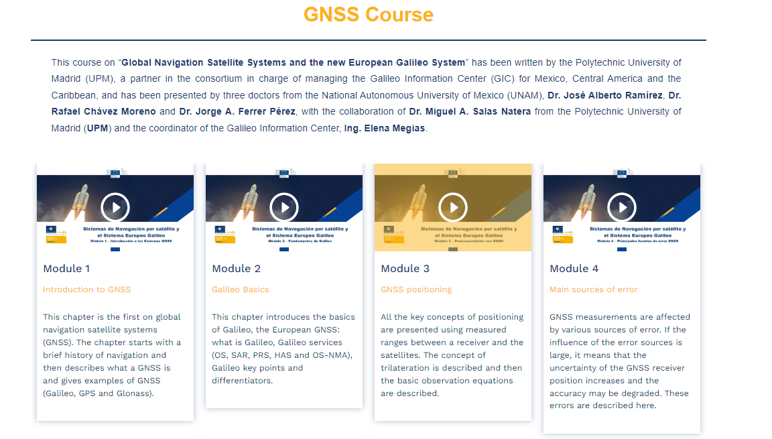
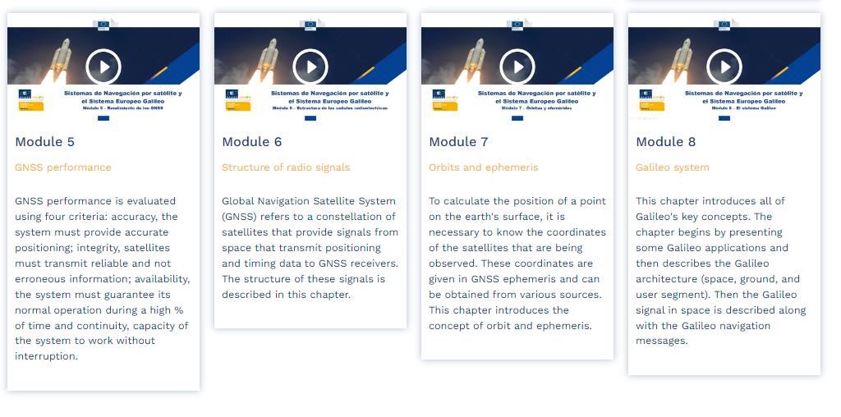
WP4000 - Education and training on GNSS-related issues (UPM)
T4200: Provision of courses and organisation of training seminars in the field of GNSS technology and applications
  The GIC team has edited the recordings of the 5 sessions of the course on GNSS that was given at UNAM as part of its inter-semester course programme, from 1 to 7 February 2023, so that it can be offered as an online GNSS course. Once the course was reviewed by the EC, it was published on the GIC website in July 2023.
    The most popular module is #7 (Orbits and ephemeris) seen by 66 people in a month and a half, closely followed by module #1 (Introduction to GNSS) seen by 60 people in the same time frame.

Slide 16
WP5000 - Industrial collaborations between Latam and European partners (TPZ IB)
T5100: Organisation of matchmaking events for industry (TPZ IB)
  AEM, as a subcontractor of the GIC Consortium, and Telespazio Ibérica jointly organised the Industry Day. The event took place on 27 April 2023 during FAMEX2023.
  The event offered participants the opportunity to familiarise themselves with the potential of the Galileo system in combination with other GNSS.
  The event also included a session that gave attendees time to establish informal contacts with other companies that attended and were able to become partners. There were both local and European companies.
  A dedicated report Industry_day_report.docx has been prepared and delivered to the EC on 21st July 2023.
  More details on the Industry Day here: https://www.youtube.com/watch?v=I8Wo2fhcXr0
m1 | m2 | m3 | m4 | m5 | m6 | m7 | m8 | m9 | m10 | m11 | m12 | m13 | m14 | m15 | m16 | m17 | m18 | m19 | m20 | m21 | m22 | m23 | m24 | m25 | m26 | m27 | m28 | m29 | m30 | m31 | m32 | m33 | m34 | m35 | m36
T5100
T5200
T5300
D5.1 update
T5400
T5500
D5.1 update
D5.1 Report on the organisation of matchmaking events on GNSS between stakeholders from the EU and Mexico and the region.

Slide 17
WP6000 – Management & Coordination with GICs (TPZ IB)
T6100: Contractual management (TPZ IB)
  Contractual and project management continues as planned.
  4th of May of 2023, M8 Progress Meeting held. 9th of May 2023, MoM delivered to the EC.
  21st of July 2023, the tenth Progress report (D6.2.10-0100-Progress Report) generated and delivered to the EC.
T6200: Management of the Centre’s own documents (TPZ IB)
  The management of the project and GIC’s documentation continues as planned.
    Communication material and deliverables submitted to the EC at M9 (gathered in the ftp folder).
  T6300: Management of interfaces with other Galileo Information Centres in Latin America and the GSC (TPZ IB)
  Participation of GSC expert in the business session for the Hackathon winners held on 07/06/23.
  Preparations have begun for the closing ceremony and GNSS networking session of the GIC. It will be a hybrid event to be held on 26 October 2023 in Mexico City (Palacio de la Minería).
m1 | m2 | m3 | m4 | m5 | m6 | m7 | m8 | m9 | m10 | m11 | m12 | m13 | m14 | m15 | m16 | m17 | m18 | m19 | m20 | m21 | m22 | m23 | m24 | m25 | m26 | m27 | m28 | m29 | m30 | m31 | m32 | m33 | m34 | m35 | m36
T6100
D6.4 Update.
T6200
T6300
D6.2.X Progress reports (at each milestone)
D6.4 Report on the liaison activities with other Galileo Information centres in Latin America.

Slide 18
Deliverables at M9
WP | Deliverable | Due date or periodicity | Status | Date
1000 | D1.3 – Contacts dataset | T0+30 | Updated | 21/07/2023
2000 | D2.2 – Project documentation (brochures) and update | T0+30 | Updated | 21/07/2023
2000 | D2.5 – Report GNSS conferences and trade exhibitions | T0+30 | Updated | 21/07/2023
3000 | D3.1 – Plan for development of GNSS-related application and services in Mexico and in the region | T0+30 | Updated | 21/07/2023
5000 | D5.1 – Report on the organisation of matchmaking events on GNSS between stakeholders from the EU and Mexico and the region | T0+30 | Updated | 21/07/2023
6000 | D6.2.10 – Progress report (M9) | T0+30 | Delivered | 21/07/2023
6000 | D6.4 – Report on the liaison activities with other Galileo Information centres in Latin America | T0+30 | Updated | 21/07/2023

Slide 19
Project way forward – next steps

Slide 20
Next steps
T0+27m
T0+30m
T0+33m
April 2023
May 2023
June 2023
July 2023
August 2023
September 2023
October 2023
WP1000
D1.3 update
WP3000
T3100: Provision of ideas for new GNSS applications and services
T3200: Support New EGNSS Applications developments
Technical notes on Road, Geomatics, Manned aviation and Emergencies
Publish the technical notes on the website
T3200: Support New EGNSS Applications developments
Business support and Copernicus sessions winners GalileoGICkathon
WP4000
T4100: Cooperation between Universities from Mexico to provide high-level education & PhD
Engineering course materials & internships
4 tesis related to GNSS technology and applications
T4200: Provision of courses and organization of training seminars
Publication of the GNSS course on the GIC website
T4300: Promotion and demonstration
Implementation of the demonstrator & other promotion activities

Slide 21
Next steps
T0+27m
T0+30m
T0+33m
April 2023
May 2023
June 2023
July 2023
August 2023
September 2023
October 2023
WP2000
T2100: Communication strategy
Continuous communication activities: website and social media, direct marketing, webinars
Webinars on Galileo SAR
Webinar for companies of Querétaro
Hybrid talk on the Galileo System (30/08/2023 Costa Rica)
D2.1 update
T2200: Elaboration and dissemination of a set of documents on European Union GNSS programmes
Ad-hoc communication material
T2400: Organization of information sessions on the EU Research and Innovation programmes
T2500: Participation in GNSS conferences and trade exhibitions
FAMEX 2023 (Mexico, 26-29 April 2023)
First meeting with ALCE
T2600: Support to the integration of Galileo in the region’s plans for GNSS

Slide 22
Next steps
T0+27m
T0+30m
T0+33m
April 2023
May 2023
June 2023
July 2023
August 2023
September 2023
October 2023
T5100: Organization of matchmaking events for industry
T5200: Fostering closer contacts between entities involved in GNSS
Session #6 WGs
T5300: Facilitation of several high-level meetings and EC/GSA outreach
T5400: Interface with the European External Action Service
T5500: Interface with the chambers of commerce
Several meetings with AEM

Slide 23
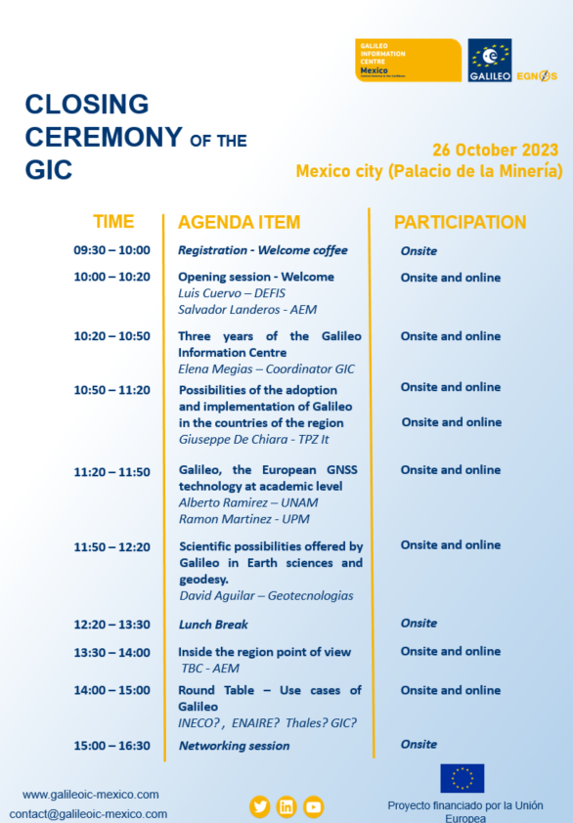
Next steps
T0+27m
T0+30m
T0+33m
April 2023
May 2023
June 2023
July 2023
August 2023
September 2023
October 2023
T6000: Management
Closing ceremony and GNSS networking session of the GIC (26/10/2023 Online/Onsite)

Slide 24
Review of actions and risks

Slide 25
Risks
Risk | Likelihood/ impact | WP | Mitigation measures
Not addressing project tasks homogeneously for all target countries Language concerns. Failure to address English-speaking Caribbean countries correctly if all the activities are developed in Spanish | Medium/ medium | All | To control the project activities and the addressed countries. Control mechanisms for each WP evaluating the response from different countries and include it in internal periodic reports. Provide all communication material both in English and Spanish. Analyse the attendees registered before the events in order to identify English speakers. Offer alternative sessions to English speakers.
Matchmaking activities (Working groups) not fit-for-purpose, with a negative impact on the project results | Low/Medium | WP5000 | To control the matchmaking activities attendance and results in order to be able to adapt future sessions to obtain better results

Slide 26
Risks
Risk | Likelihood/ impact | WP | Mitigation measures
Risk of not incorporation of the AEM as a partner | Medium/ Low | All | Include the AEM as a subcontractor of the project
Not achieving the goal of drafting a GNSS Roadmap | Medium/Medium | WP2000 | To hold dedicated meetings with institutions on the area covered by the centre to discuss the GNSS roadmap.
Low level of physical activities | Medium/Medium | All | As travel restrictions for public health reasons are no longer applied, setting up hybrid (on-line and on-site) sessions to engage more people.

Slide 27
Actions
ID | Action Description | Source | Responsible | Status | Due date | Comments
AI-21 | To organize several webinars (topic to be discussed) for central America an English speaking countries of the region | M7 | TPZIB | Open |  | Webinars on Galileo SAR are planned for Central America countries (Guatemala, Venezuela, Colombia) September 21 Webinar in Costa Rica took place (August 30)

Slide 28
AoB

Slide 30

GIC Mexico Progress Meeting
(Mexican Space Agency activities)
07/09/2023

Slide 31
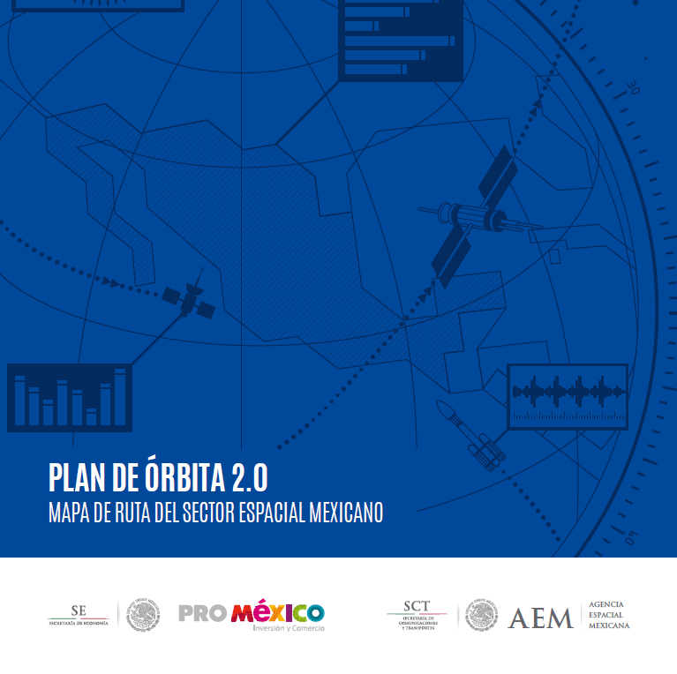
Mexican Space Agency
Strategic GNSS Alignment
National Space Activities Program 2020-2024
Priority Objective 1 - Identify prospects and promote the development of space infrastructure for telecommunications, navigation, global positioning and their applications, which favor digital transformation and the supply of services to contribute to well-being, social inclusion and economic development.
Orbit Plan 2.0.
Milestone 1 - Address the needs of converging public and private markets linked to the space sector, including GNSS applications such as positioning, synchronization, management and monitoring.

Slide 32




















Mexican Space Agency
Strategic GNSS Alignment
32

Slide 33
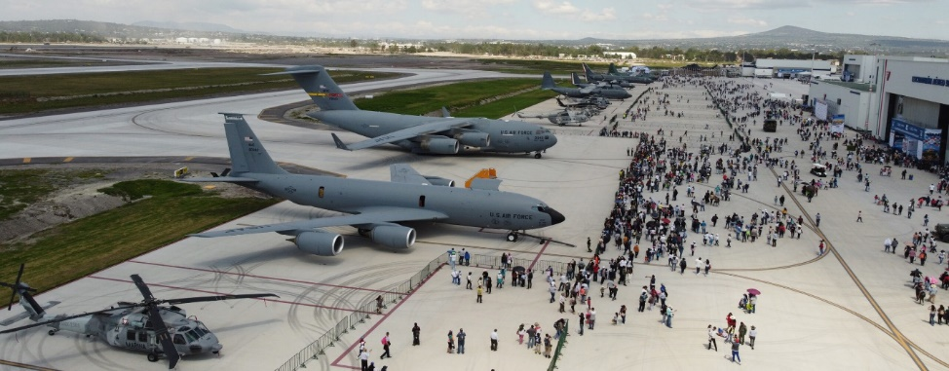
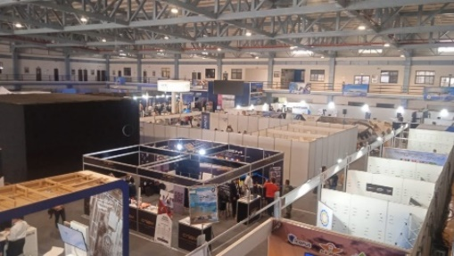
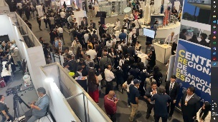
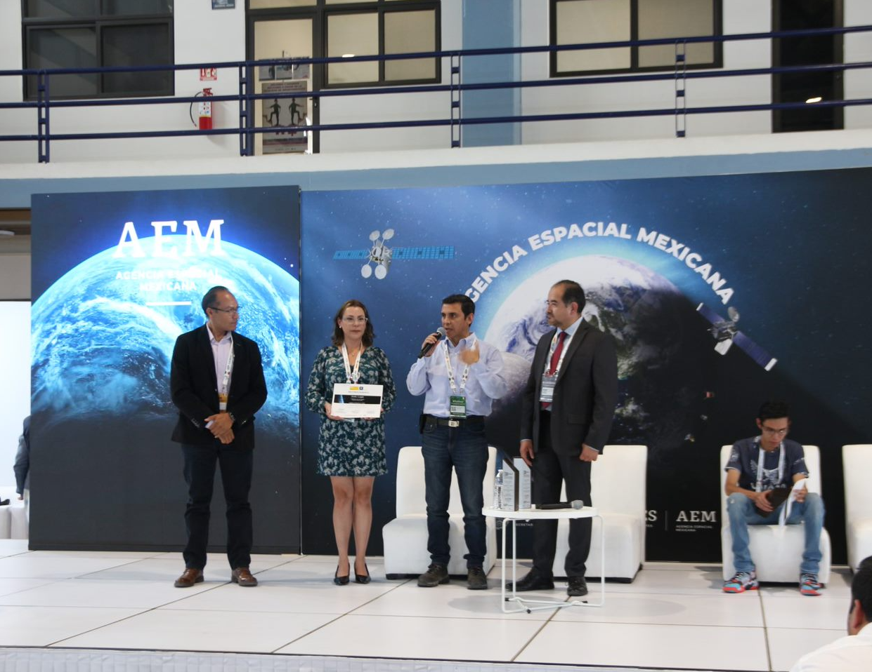
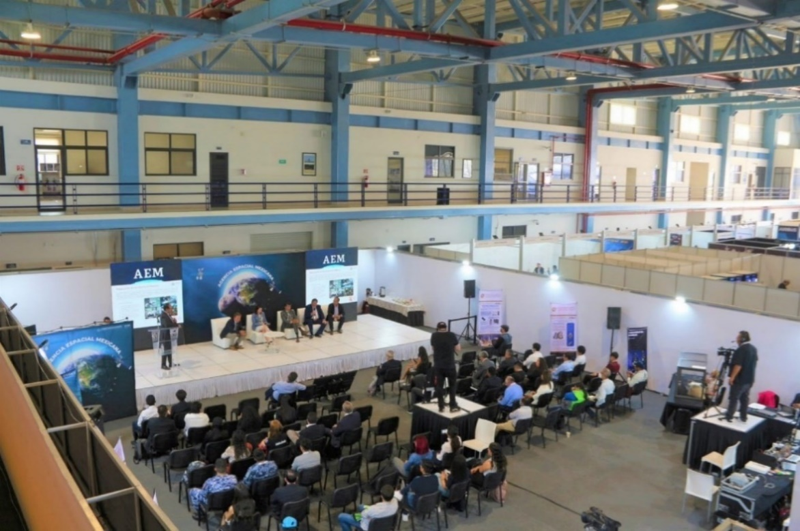
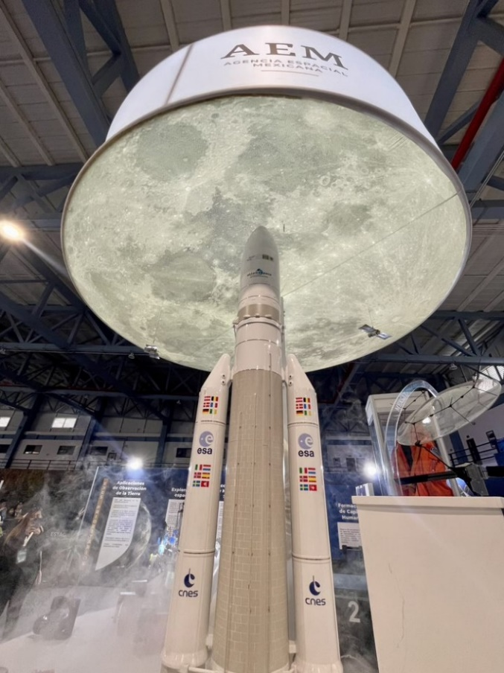
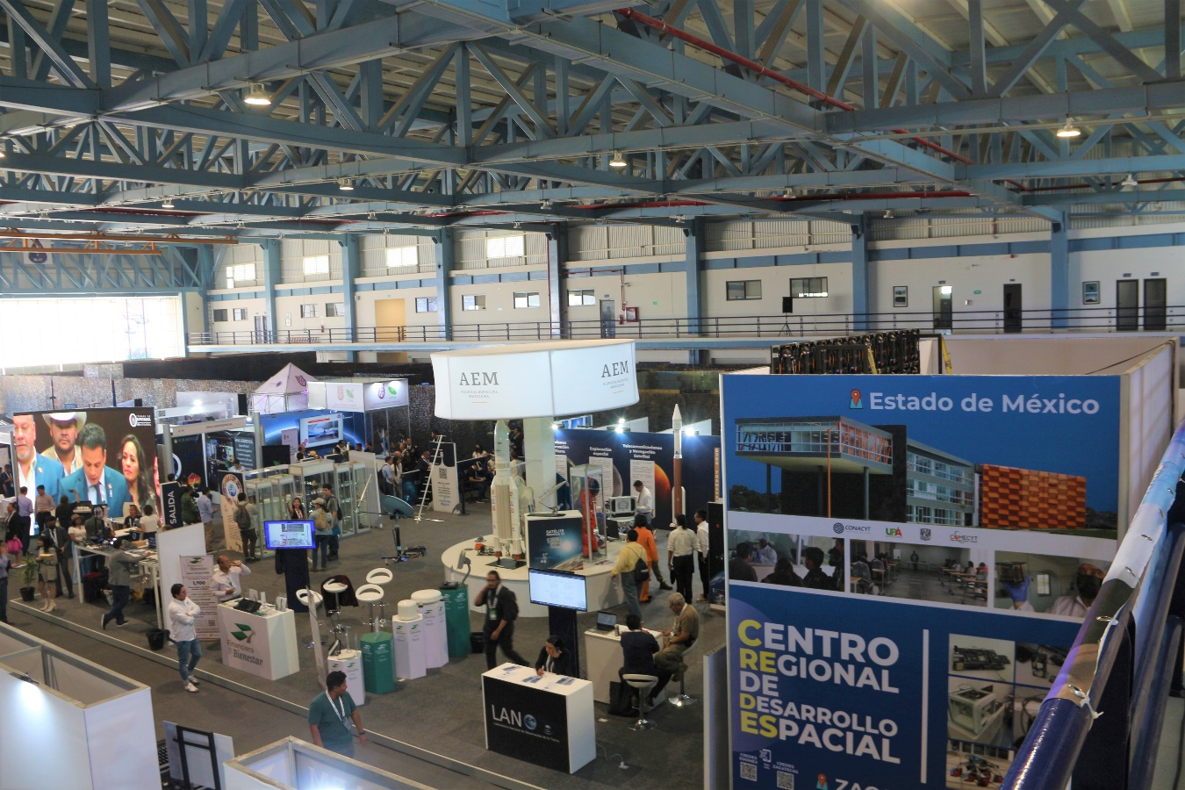
FAMEX 2023
GNSS Industry Day
April 26-29, 2023
Military Air Base No.1 Santa Lucia, Mexico State

Slide 34
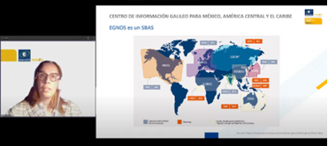
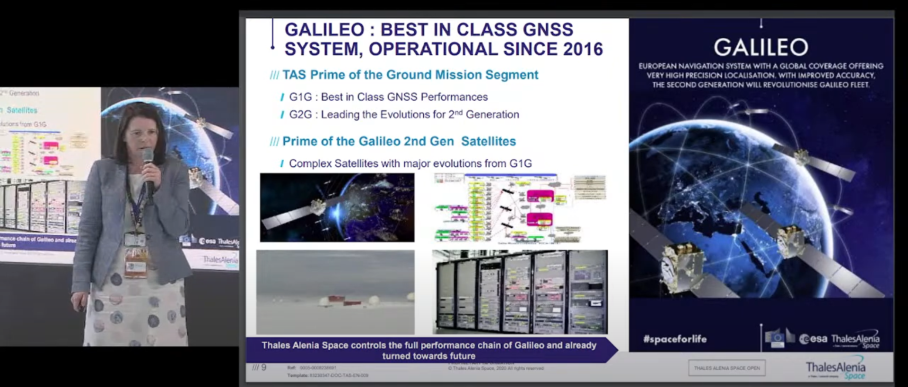
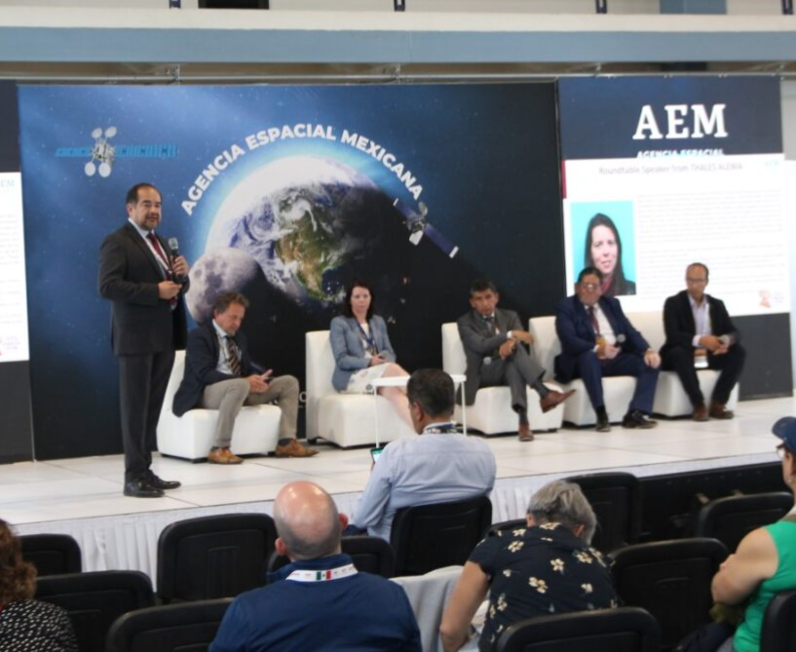
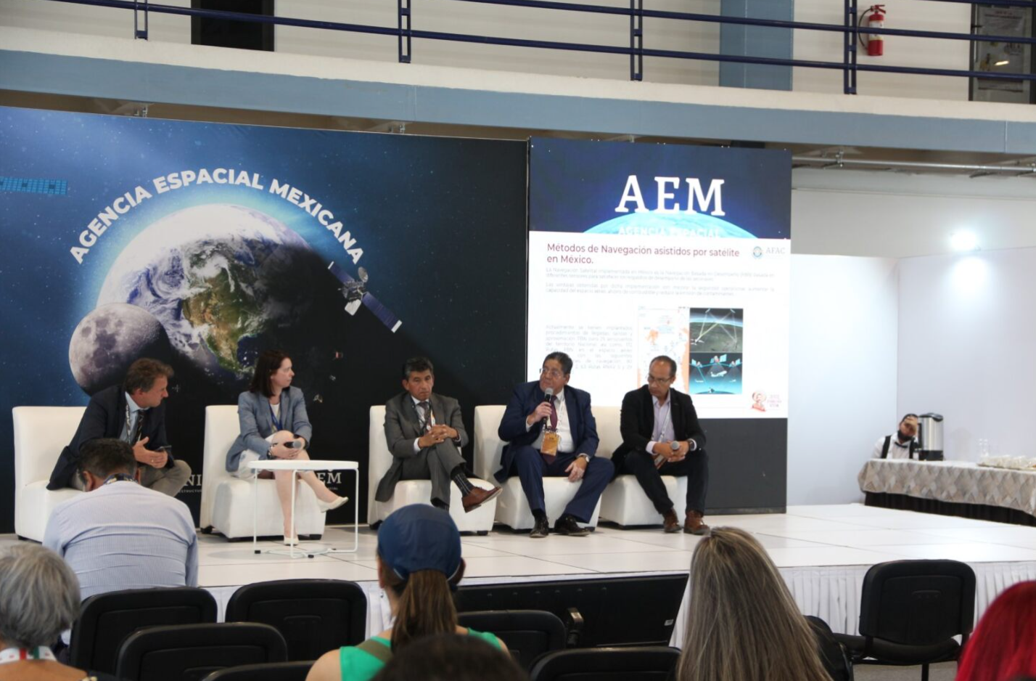
FAMEX 2023
GNSS Industry Day
GNSS Conferences during FAMEX 2023
Galileo Information Centre and European space programmes
GNSS interests and Thales Alenia GNSS portfolio
Round Table
GNSS Systems in Aircraft Navigation and Drones

Slide 35
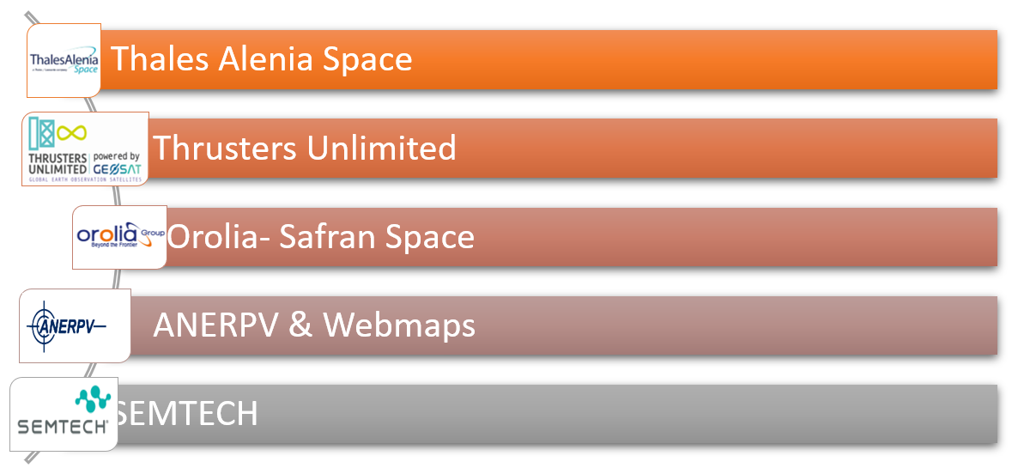
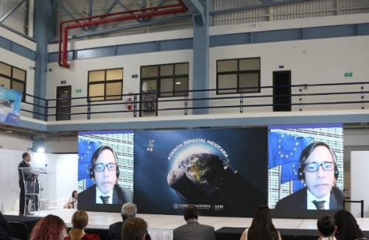
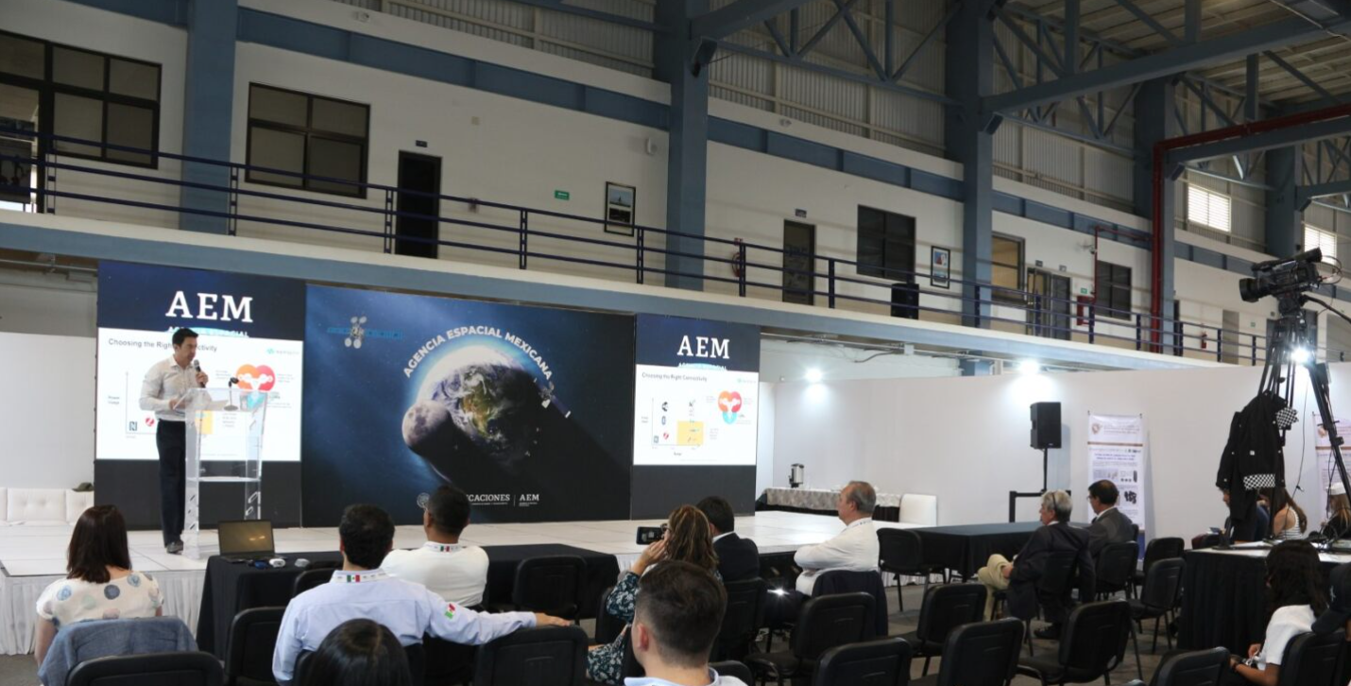
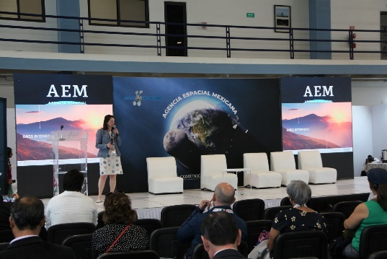
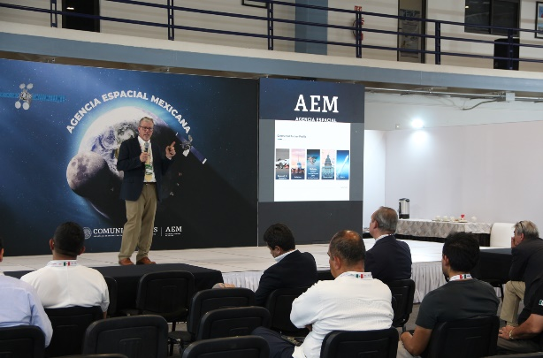
FAMEX 2023
GNSS Industry Day
Networking Meeting
Notes:
National Association of Vehicle Tracking and Protection Companies

Slide 36
FAMEX 2023
GNSS Industry Day
Networking Meeting
The auditorium had a seating capacity of 80 people, and the 145 invitations were distributed among universities, companies that use GNSS within their value chain, representatives from all aerospace clusters, Aeroespace Industry Mexican Federation (FEMIA) members, research institutions, as well as regulatory entities, and finally, commercial representatives from the embassies of countries covered by GIC Mexico's coverage.

Slide 37








FAMEX 2023
GNSS Industry Day
Networking Meeting
AQUOSMIC
BGBG (Telecommunications and Space Lawyer)
DTA Argentina
DTA México
General Electric
Ifly
National Polytechnic Institute (IPN-CDA)
Kokoro Universe
National Earth Observation Laboratory (UNAM)
ORACLE
University Space Program (UNAM)
Space Zero Gravity
SPEKTRO
Tecnología en Sistemas de Apoyo (TSA)
Motolínia del Pedregal University
National Polytechnic Institute (IPN)
National Technological Institute of Mexico (TECNM)
National Technological Institute of Mexico (TECNM)
Autonomous University of the State of Mexico (UAEMEX)
Motolínia del Pedregal University
Popular Autonomous University of the State of Puebla (UPAEP)
The business community was successfully presented with the GNSS technologies represented by each panelist, the key business trends in this space sector, and their respective visions for the near future in countries like Mexico and the surrounding region.
Through online platforms, a wide audience from Mexico and other countries in the region was reached.
Some commercial relationships were initiated between the guests and the invited companies, aiming to kickstart or enhance initiatives in such applications.
While there was no specific tool to quantify the resulting business matching prospects from this Industry Day, an audience count within the auditorium was below expectations.
Within the AEM's work agenda, the dissemination of GNSS technologies and the organization of industrial meetings on commercial topics related to this niche in the satellite industry will continue to be prioritized.

Slide 38

serrano.antonio@aem.gob.mx

